Slide 1

“Motorbike Defect Checker and Predictor”
Android App to identify vehicle auto parts altered and their usage prediction
Project ID: TMP 23 - 383

Slide 2
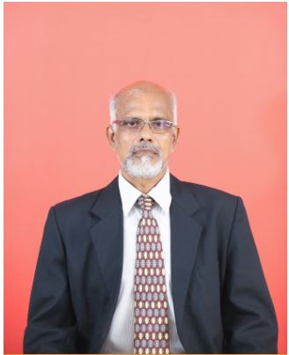

Supervision Personalities
MOTORBIKE DEFECT CHECKER AND PREDICTOR
Supervisor :
Co - Supervisor :
Dr. Amithalal Caldera
Senior Lecturer (Higher Grade)
Faculty of Computing | Information Technology
Ms. Supipi Karunathilaka
Instructor
Faculty of Computing | Information Technology

Slide 3

Team Members
MOTORBIKE DEFECT CHECKER AND PREDICTOR
IT20219598 - S.L.D.P Pramodya
IT20257040 - A.M.K.A.P Amarasingha
IT20261764 - D.M.D.H Dissanayake
IT20156206 - Rathnasooriya P.U.

Slide 4
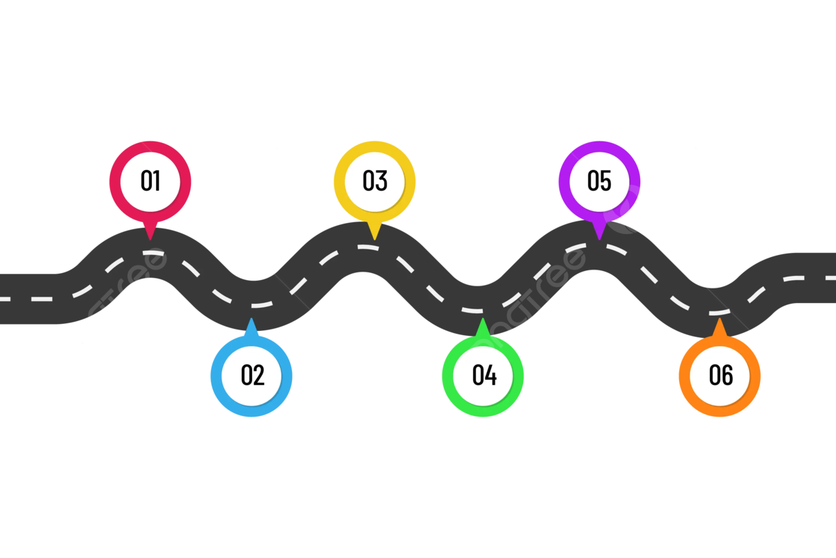
Roadmap
MOTORBIKE DEFECT CHECKER AND PREDICTOR
Results and Discussions. & Conclusion
Introduction
Main objectives
Research Problem & Solution
Overall System Diagram
Individual Components

Slide 5
Introduction
MOTORBIKE DEFECT CHECKER AND PREDICTOR
1.Research problem
2. Solution
3. Main objectives
4. Overall System Diagram
5.Results and Discussions.
6.Conclusion

Slide 6
01. Research Problem
MOTORBIKE DEFECT CHECKER AND PREDICTOR
The problem that we have identified is that when an individual tries to purchase a vehicle (Motorbike) he will not be able to identify the defects, auto parts fixed as an alternative to original parts, engine defects, usage of the current tyres, vehicle details and the registration paper details comparison.

Slide 7

02. Solution
MOTORBIKE DEFECT CHECKER AND PREDICTOR
As a solution, our team has come up with a Mobile Application which is based on the sub-section of Machine Learning (ML) which is called Image Processing and a vast database with all the necessary data regarding auto parts to solve this issue.

Slide 8
03. Main Objectives
MOTORBIKE DEFECT CHECKER AND PREDICTOR
Capture images of the auto parts in the vehicle and compare them with the original parts and provide a summary regarding the altered parts.
Capture the sound of the engine and provide a summary of the engine’s current condition and a prediction of future fault occurrences.
Capture an image of the Registration paper and compare it to the bike’s original details.
Capture the images of tyres and predict the usage and possible life expectation.

Slide 9
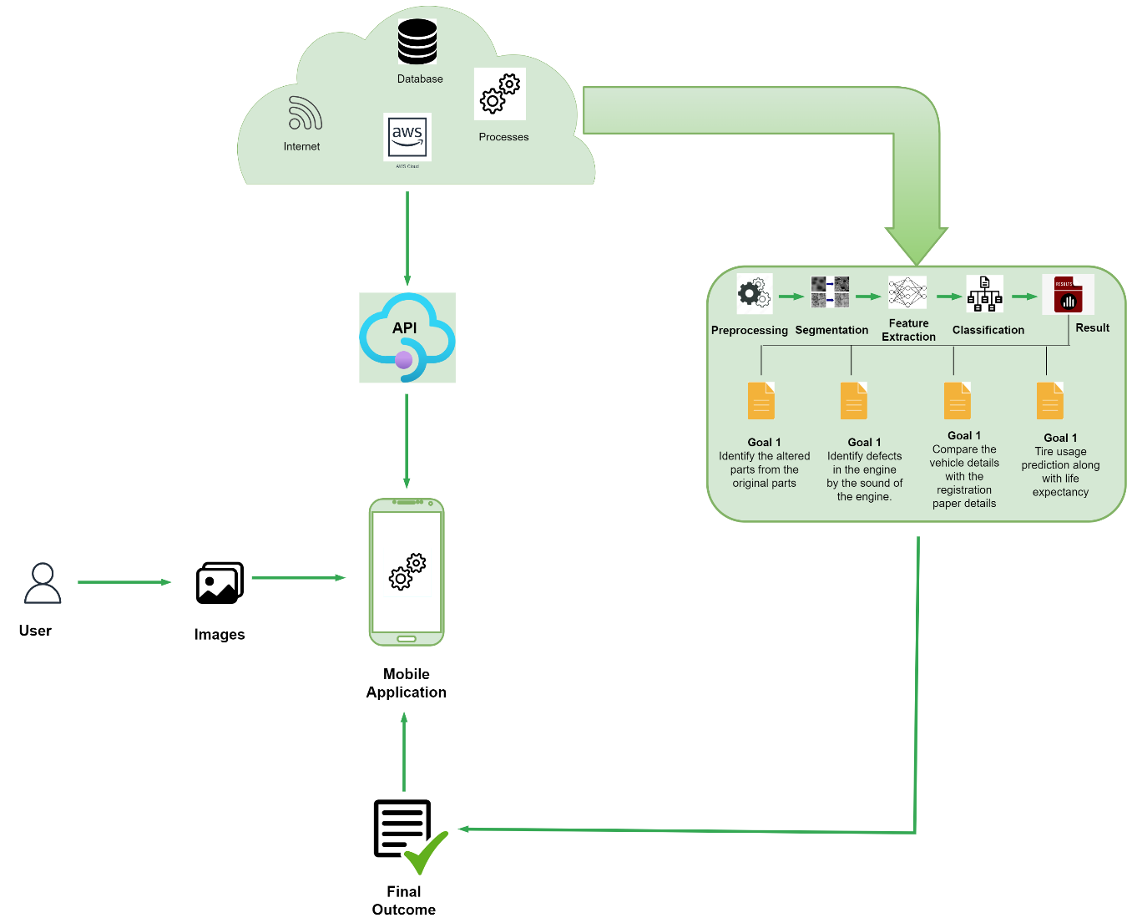
04. Overall System Diagram
MOTORBIKE DEFECT CHECKER AND PREDICTOR

Slide 10
05. Results and Discussions.
MOTORBIKE DEFECT CHECKER AND PREDICTOR

Slide 11
06.Conclusion.
MOTORBIKE DEFECT CHECKER AND PREDICTOR

Slide 12

IT20219598 |Information Technology
MOTORBIKE DEFECT CHECKER AND PREDICTOR
S.L.D.P Pramodya

Slide 13

Research Question
MOTORBIKE DEFECT CHECKER AND PREDICTOR
How to identify altered parts in a motorbike fixed except original parts?
IT20219598 | S.L.D.P Pramodya | TMP-23-383

Slide 14

Research Methodology
MOTORBIKE DEFECT CHECKER AND PREDICTOR
Capture images of the original parts and altered versions.
Train the ML model using the data set
Compare the images captured with the images in our trained models.
Color pre-processing
Conversion to binary image
Provide an output regarding the alternation
IT20219598 | S.L.D.P Pramodya | TMP-23-383

Slide 15
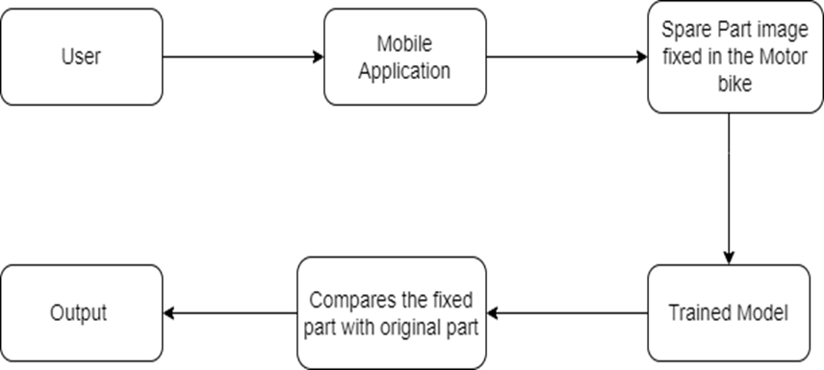
Research Methodology
MOTORBIKE DEFECT CHECKER AND PREDICTOR
IT20219598 | S.L.D.P Pramodya | TMP-23-383

Slide 16

MOTORBIKE DEFECT CHECKER AND PREDICTOR
Completion of the System
Component | Status of Completion
Object Recognition Models
Image Processing
Feature Extraction
IT20219598 | S.L.D.P Pramodya | TMP-23-383

Slide 17

Progress up to now
MOTORBIKE DEFECT CHECKER AND PREDICTOR
Completion of the System
IT20219598 | S.L.D.P Pramodya | TMP-23-383

Slide 18
MOTORBIKE DEFECT CHECKER AND PREDICTOR
Completion of the System
IT20219598 | S.L.D.P Pramodya | TMP-23-383

Slide 19
MOTORBIKE DEFECT CHECKER AND PREDICTOR
Completion of the System
IT20219598 | S.L.D.P Pramodya | TMP-23-383

Slide 20

MOTORBIKE DEFECT CHECKER AND PREDICTOR
Progress at the moment
The needed image data sets have been found to train the models.
Completion of the System
What’s to be done
IT20219598 | S.L.D.P Pramodya | TMP-23-383

Slide 21
References
MOTORBIKE DEFECT CHECKER AND PREDICTOR
[1]
https://www.researchgate.net/profile/Ashfaq
Shafin/publication/344519283_Automatic _Environmental_Sound_Recognition_AES R_Using_Convolutional_Neural_Network/l inks/5f7de369458515b7cf6f22d7/Automa tic-Environmental-Sound-RecognitionAESR-Using-Convolutional-NeuralNetwork.pdf
Completion of the System
[2]
https://www.autopartspro.co.uk/
[3]
“Toyota Accessories Augmented Reality [TAAR] App. (2021, November 17). Groove Jones. https://www.groovejones.com/toyota-accessories-augmented-reality-taar-app/
In-Text Citation: (Toyota Accessories Augmented Reality [TAAR] App, 2021)
IT20219598 | S.L.D.P Pramodya | TMP-23-383

Slide 22

IT20257040 |Information Technology
MOTORBIKE DEFECT CHECKER AND PREDICTOR
A.M.K.A.P Amarasingha

Slide 23
Research Question
MOTORBIKE DEFECT CHECKER AND PREDICTOR
How to identify defects of an engine by the sound of the engine heard?
IT20257040 | A.M.K.A.P Amarasingha| TMP-23-383

Slide 24

Research Methodology
MOTORBIKE DEFECT CHECKER AND PREDICTOR
Capture Voice of engine.
We are going to train a voice-recognition model with sound clips of healthy motorbike engines and unhealthy ones and for the processing
Analyze the sound
The user will have to record a few voice clips of the sound of the engine to identify whether the strange noise is of these 1. Tick, tick tick, 2. Bump & grind, 3. Creepy krink, 4. Boo hiss, 6. Snap, crackle, pop.
IT20257040 | A.M.K.A.P Amarasingha| TMP-23-383

Slide 25
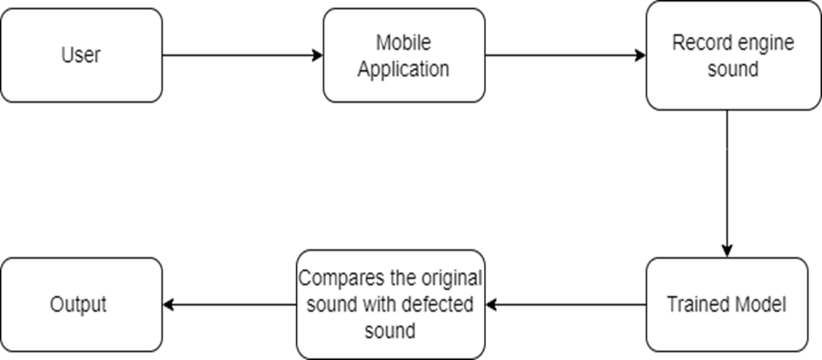
Research Methodology
MOTORBIKE DEFECT CHECKER AND PREDICTOR
IT20257040 | A.M.K.A.P Amarasingha| TMP-23-383

Slide 26

MOTORBIKE DEFECT CHECKER AND PREDICTOR
Completion of the System
Component | Status of Completion
Sound Processing
Feature Extraction
Sound Recognition Models

Slide 27
Progress up to now
MOTORBIKE DEFECT CHECKER AND PREDICTOR
Completion of the System
IT20257040 | A.M.K.A.P Amarasingha| TMP-23-383

Slide 28
MOTORBIKE DEFECT CHECKER AND PREDICTOR
Completion of the System
IT20257040 | A.M.K.A.P Amarasingha| TMP-23-383

Slide 29
MOTORBIKE DEFECT CHECKER AND PREDICTOR
Progress at the moment
The needed image data sets have been found to train the models.
Completion of the System
What’s to be done
IT20257040 | A.M.K.A.P Amarasingha| TMP-23-383

Slide 30
References
MOTORBIKE DEFECT CHECKER AND PREDICTOR
[1]
Ilminen, Gary. “Top 6 Strange Motorcycle Noises | What They May Mean.” Ultimate Motorcycling, 29 Mar. 2016, ultimatemotorcycling.com/2016/03/29/to p-6-strange-motorcycle-noises-what-theymay-mean.
[2]
https://www.researchgate.net/profile/Ashfaq
Shafin/publication/344519283_Automatic _Environmental_Sound_Recognition_AES R_Using_Convolutional_Neural_Network/l inks/5f7de369458515b7cf6f22d7/Automa tic-Environmental-Sound-RecognitionAESR-Using-Convolutional-NeuralNetwork.pdf
Completion of the System
[3]
Upadhyay, A., Li, J., King, S., & Addepalli, S. (2023, February 1). A Deep-Learning-Based Approach for Aircraft Engine Defect Detection. MDPI. https://doi.org/10.3390/machines11020192
In-Text Citation: (Upadhyay et al., 2023)
IT20257040 | A.M.K.A.P Amarasingha| TMP-23-383

Slide 31

IT20261764 |Information Systems Engineering
MOTORBIKE DEFECT CHECKER AND PREDICTOR
D.M.D.H Dissanayake

Slide 32
Research Question
MOTORBIKE DEFECT CHECKER AND PREDICTOR
How to identify major details of a motorbike if the details on the motor bike are worn out, rusted, not clear ?
IT20261764 | D.M.D.H Dissanayake | TMP-23-383

Slide 33
Research Methodology
MOTORBIKE DEFECT CHECKER AND PREDICTOR
Capture images of the vehicle details
Here user can capture the images of the registration paper, engine number, chassis number, color, and number plate.
Compare the images of captured with manual inputs
Color pre-processing
Conversion to binary image
Output the accuracy of the details.
IT20261764 | D.M.D.H Dissanayake | TMP-23-383

Slide 34
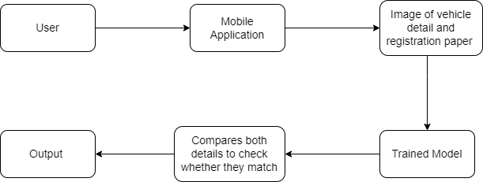
Research Methodology
MOTORBIKE DEFECT CHECKER AND PREDICTOR
IT20261764 | D.M.D.H Dissanayake | TMP-23-383

Slide 35

MOTORBIKE DEFECT CHECKER AND PREDICTOR
Completion of the System
Component | Status of Completion
Object Recognition Models
Image Processing
Feature Extraction
IT20261764 | D.M.D.H Dissanayake | TMP-23-383

Slide 36
Progress up to now
MOTORBIKE DEFECT CHECKER AND PREDICTOR
Completion of the System
IT20261764 | D.M.D.H Dissanayake | TMP-23-383

Slide 37
MOTORBIKE DEFECT CHECKER AND PREDICTOR
Completion of the System
IT20261764 | D.M.D.H Dissanayake | TMP-23-383

Slide 38
MOTORBIKE DEFECT CHECKER AND PREDICTOR
Completion of the System
IT20261764 | D.M.D.H Dissanayake | TMP-23-383

Slide 39
MOTORBIKE DEFECT CHECKER AND PREDICTOR
Progress at the moment
The needed image data sets have been found to train the models.
Completion of the System
What’s to be done
IT20261764 | D.M.D.H Dissanayake | TMP-23-383

Slide 40
References
MOTORBIKE DEFECT CHECKER AND PREDICTOR
[1]
Department of Motor Traffic. (n.d.). Department of Motor Traffic. https://dmt.gov.lk/
In-Text Citation: (Department of Motor Traffic, n.d.)
[2]
“How Optical Character Recognition Algorithms Redefine Business Processes &Mdash; ITRex.” ITRex, 6 Apr. 2022, itrexgroup.com/blog/how-ocr-algorithmsredefine-business-processes.
Completion of the System
[3]
https://www.researchgate.net/profile/Ashfaq
Shafin/publication/344519283_Automatic _Environmental_Sound_Recognition_AES R_Using_Convolutional_Neural_Network/l inks/5f7de369458515b7cf6f22d7/Automa tic-Environmental-Sound-RecognitionAESR-Using-Convolutional-NeuralNetwork.pdf
IT20261764 | D.M.D.H Dissanayake | TMP-23-383

Slide 41

IT20156206 | Data Science
MOTORBIKE DEFECT CHECKER AND PREDICTOR
Rathnasooriya P.U.

Slide 42
Research Question
MOTORBIKE TYER USAGE AND LIFE EXPECTANCY PREDICTOR
How to identify Motorbike tyer usage and Life expectancy prediction system with computer vision and a machine learning model.

Slide 43
Research Methodology
MOTORBIKE TYER USAGE AND LIFE EXPECTANCY PREDICTOR
Capture images of tyres.
Here user can capture or upload an image of a tyre and predict usage and life expectancy.
Output the usage details and Life expectancy.
IT20156206 | Rathnasooriya P. U | TMP-23-383

Slide 44
MOTORBIKE TYER USAGE AND LIFE EXPECTANCY PREDICTOR
Completion of the System
Component | Status of Completion
Gathering datasets | 95%
Vision transformer model to predict the usage | 80%
Output the predicted life expectancy of the tyre | 10%

Slide 45
Progress up to now
MOTORBIKE TYER USAGE AND LIFE EXPECTANCY PREDICTOR
Completion of the System
IT20156206 | Rathnasooriya P. U | TMP-23-383

Slide 46
MOTORBIKE DEFECT CHECKER AND PREDICTOR
Completion of the System
IT20156206 | Rathnasooriya P. U | TMP-23-383

Slide 47
MOTORBIKE DEFECT CHECKER AND PREDICTOR
Completion of the System
IT20156206 | Rathnasooriya P. U | TMP-23-383

Slide 48
MOTORBIKE DEFECT CHECKER AND PREDICTOR
Completion of the System
IT20156206 | Rathnasooriya P. U | TMP-23-383

Slide 49
MOTORBIKE TYER USAGE AND LIFE EXPECTANCY PREDICTOR
Progress at the moment
Collected the required dataset having 200 images for each class.
Created the model for tyre usage prediction.

Slide 50
MOTORBIKE TYER USAGE AND LIFE EXPECTANCY PREDICTOR
What’s to be done

Slide 51
References
MOTORBIKE TYER USAGE AND LIFE EXPECTANCY PREDICTOR
[1] J. Zhu, K. Han, and S. Wang, “Automobile tire life prediction based on image processing and machine learning technology,” Advances in Mechanical Engineering, vol. 13, no. 3, p. 168781402110027, Mar. 2021, doi: https://journals.sagepub.com/doi/10.1177/16878140211002727
[2] V. Pagliarulo et al., “Combining ESPI with laser scanning for 3D characterization of racing tyres sections,” Optics and Lasers in Engineering, vol. 104, pp. 71–77, May 2018, Available: https://doi.org/10.1016/j.optlaseng.2017.07.004. [Accessed Mar. 20, 2023].
Completion of the System

Slide 52
Thank You !
MOTORBIKE TYER USAGE AND LIFE EXPECTANCY PREDICTOR
Completion of the System

